Slide 1

Information Management & Retrieval
Information Management and Retrieval
Supermarket Management System

Slide 2
Content
System Overview
System Objectives
System features

Slide 3
System Overview
This project that deals with supermarket automation and it includes both purchasing a selling of items. This project is designed with a goal to making the existing system more informative, reliable, fast, and easier. There are many reasons for the starting of the project because in the selling of items through the manual system of salesperson faces a lot of inefficiencies. It requires handling of large record books that consist of both irrelevant and important information’s thus making it difficult to find out the required information as per necessity.
The administrators consist of a unique password and names of the employees. It helps the employees to make secure login. The ids and passwords are kept secret from others. The modules of sales and purchase include all the details of selling and purchasing. In the billing module the details of payments are clearly shown.
This is one of the best systems, that can be introduced in the supermarket for efficient management. It will also reduce the cumbersome job of finding the most accurate data from the huge logbooks. It also helps the management to keep efficient records of all the purchases and sales. The introduction of ID and password will further reduce the manipulation and thus providing the accurate and transparent data. This system will increase the productivity and reduce the need of manual system to a large extent

Slide 4
System Objectives
The two main benefits of inventory management are that it ensures you’re able to fulfill incoming or open orders and raises profits. Inventory management also:
▪ Saves Money:
Understanding stock trends means you see how much of and where you have something in stock so you’re better able to use the stock you have. This also allows you to keep less stock at each location (store, warehouse), as you’re able to pull from anywhere to fulfill orders — all of this decrease costs tied up in inventory and decreases the amount of stock that goes unsold before it’s obsolete.
▪ Improves Cash Flow:
With proper inventory management, you spend money on inventory that sells, so cash is always moving through the business.
▪ Satisfies Customers:
One element of developing loyal customers is ensuring they receive the items they want without waiting.

Slide 5
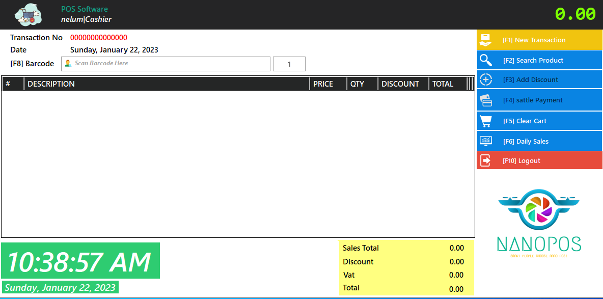
System Features
Cashier Dashboard
A cashier dashboard in this system is a user interface that allows cashiers to process transactions, such as ringing up sales, applying discounts, and accepting payments. It typically includes features like a product catalog, a calculator, and a total amount due display. The cashier can also usually access customer information, such as their purchase history, and manage inventory. Additionally, the dashboard can also provide reporting and analytics features that allow the cashier to track sales and performance.

Slide 6
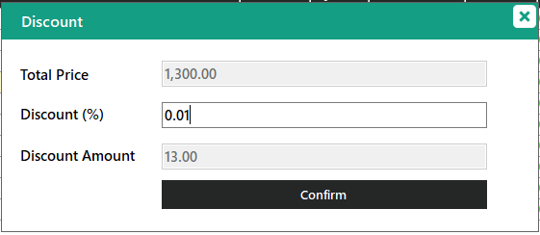
Add discount section
The discount section is a feature that allows a cashier or salesperson to apply discounts to a customer's purchase. This section typically includes options for adding a fixed rupee amount or percentage-based discounts, setting a minimum purchase amount for the discount to apply, and the ability to apply multiple discounts to a single transaction. Discounts can be applied to a single item or an entire purchase, and the system should also allow for the management of discounts such as creating, editing, and deleting discounts. This section is important for businesses that offer discounts for promotions, loyalty programs or for different categories of customers.

Slide 7
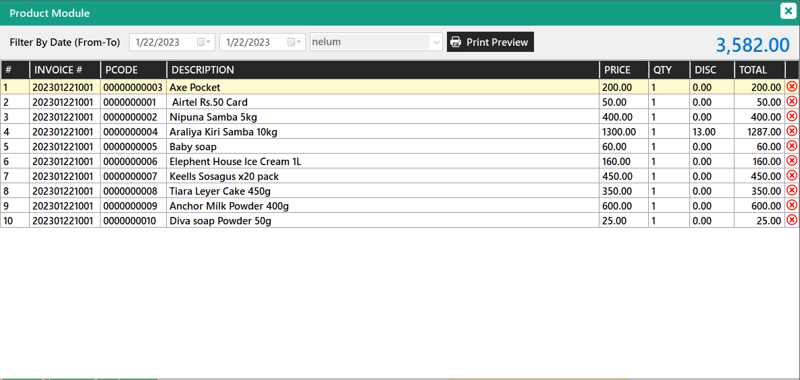
Daily sales section
The daily sales section in this system is a feature that allows a user, typically a cashier or manager, to view the total sales that have been made on a specific day. This section typically includes information such as the number of transactions, the total revenue, and possibly a breakdown of sales by product or category. It may also include the option to view sales data for previous days or periods. The daily sales section is important for monitoring the performance of a business and making informed decisions about inventory, staffing, and other operational matters.

Slide 8
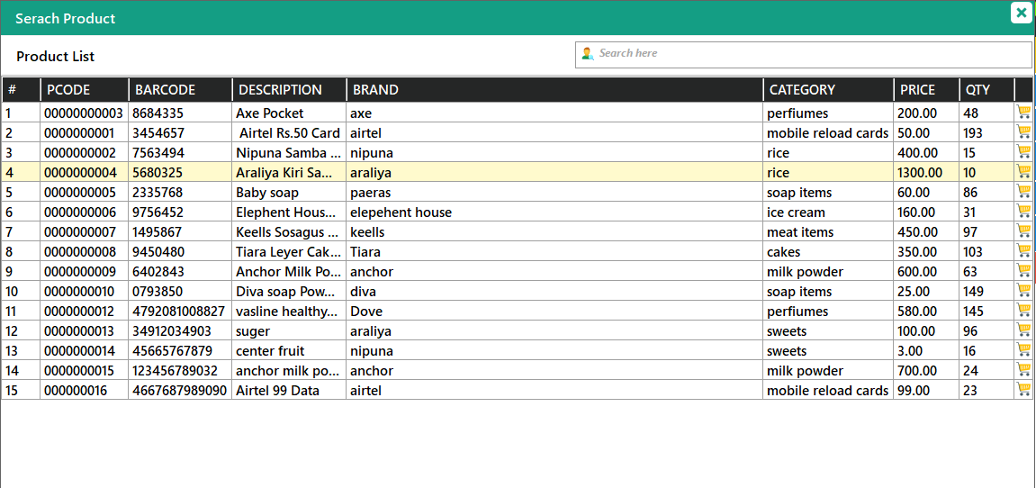
Search products section
A search product section is a feature that allows cashiers or other users to quickly locate and retrieve information about specific products within the system. This can include information such as product name, price, and inventory levels. The search functionality can be accomplished through different methods such as barcode scanning, manual entry, or pcode. The search results can also be filtered or sorted by various criteria such as category, brand, or price range. This feature greatly speeds up the checkout process, and also enables the cashier to access to real-time inventory information.

Slide 9
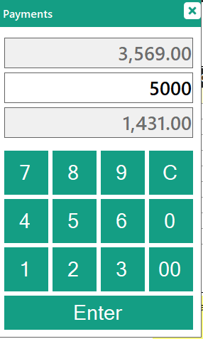
Payment section
In this feature that allows for the calculation of payments for customer transactions. This can include calculating the total amount due, applying discounts or taxes.The dashboard can also show the breakdown of the transaction and the customer's receipt. The dashboard allows for easy processing of payments and can help to improve the overall efficiency of the business by making it easy to process payments quickly and accurately.

Slide 10
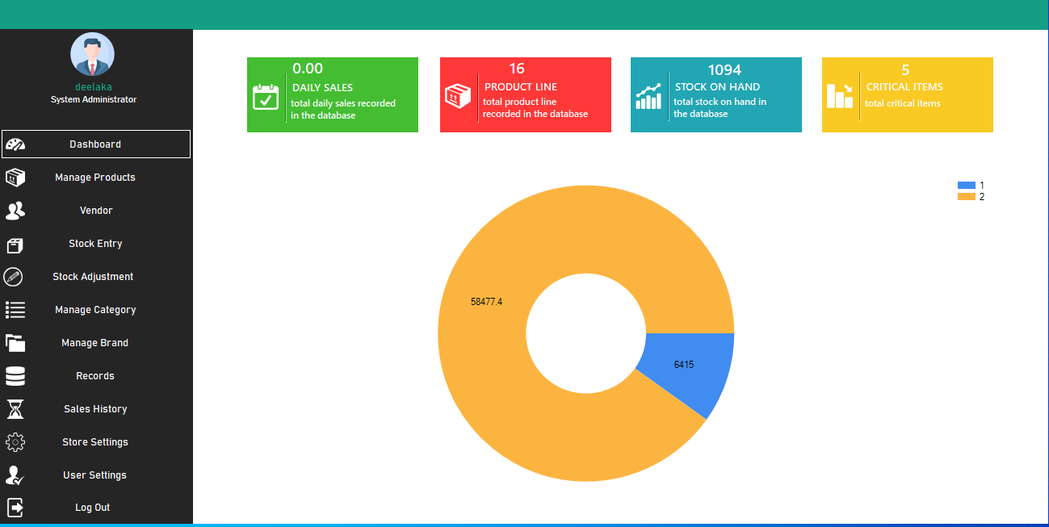
Admin Dashboard
An admin dashboard is a feature that enables the system administrator or other authorized users to manage and monitor the overall operation of the system. It typically includes features such as managing user accounts, setting up product and pricing information, managing inventory, and accessing sales and performance reports. The admin dashboard can also include options for setting up and managing various aspects of the system such as security, hardware and software settings.

Slide 11
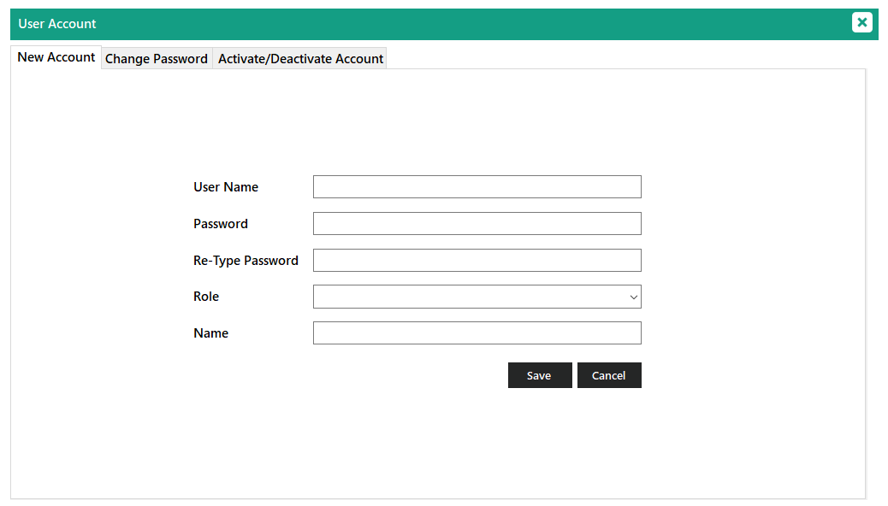
User account dashboard
A user account dashboard is a feature that allows for the creation and management of user accounts within the system. This can include setting up new employee accounts, assigning roles and permissions, and resetting passwords. The dashboard allows for easy management of employee access to the POS system and can improve security by controlling who has access to sensitive data.

Slide 12
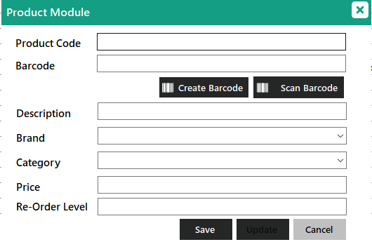
Add new product section
A “Add New Product" is a feature that allows for the addition of new products to the inventory. This can include entering product information such as name, description, price,Barcode and category. The dashboard allows for easy management of the products catalog and can help to ensure that customers are able to find and purchase the products they are looking for. Additionally, it can help to improve the overall efficiency of the business by making it easy to add new products and update existing ones.

Slide 13
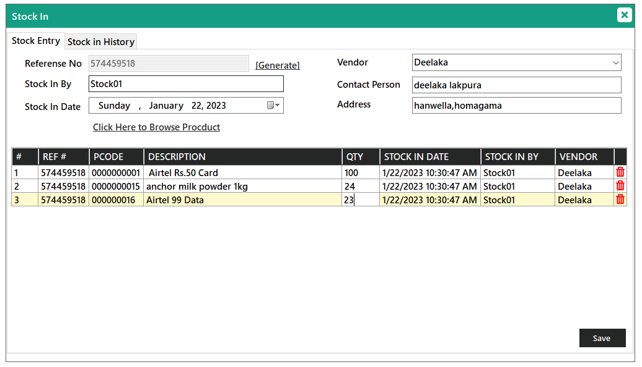
Add new stock section
A "Stock in" dashboard is a feature that allows for the management and tracking of inventory. This can include adding new items to the inventory, updating stock levels, setting reorder points, and monitoring stock levels. The dashboard allows for easy management of inventory and can help ensure that the correct amount of stock is available to meet customer demand. Additionally, it can help to reduce the risk of stockouts and can improve the overall efficiency of the business.

Slide 14
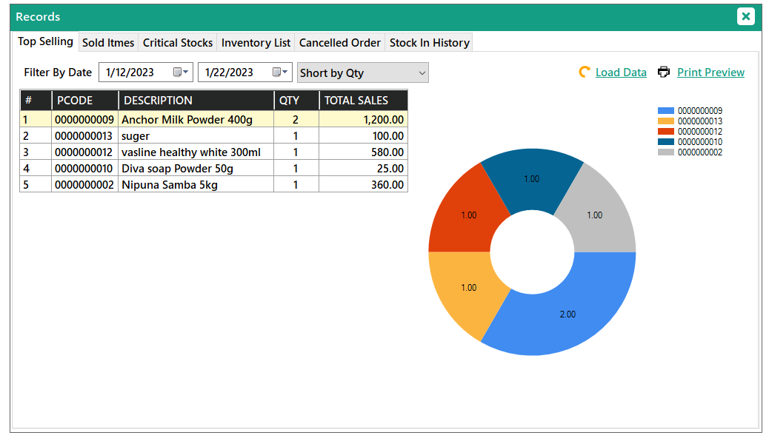
Records section
A "Records section is a feature that allows for the tracking and management of various types of transactions and data. This can include sales records, inventory list, critical list, inventory records and other types of data. The dashboard allows for easy access to important business data and can help to improve the overall efficiency of the business by providing real-time data and historical reports. Additionally, it can help to improve decision-making by providing insights into customer behavior and sales trends.

Slide 15
Thank You!

